Slide 1
FINANCIAL FRAUD DETECTION
By Ali Hamza Shaikh
https://github.com/analyticshamza/Financial-Fraud-Detection

Slide 2
BUSINESS PROBLEM
Rise in digital payments increases fraud risk
Financial institutions need early fraud detection
Manual monitoring is inefficient and costly

Slide 3
PROJECT OBJECTIVE
Identify fraudulent and suspicious transactions
Analyze spending patterns and anomalies
Support data-driven fraud monitoring

Slide 4
DATASET OVERVIEW
Transaction data (amount, category, gender, time)
Location data (city, state, latitude, longitude)
Target variable: Fraud / Non-Fraud

Slide 5
TOOLS & WORKFLOW
Excel: Initial exploration SQL: Structured analysis Python: EDA
Tableau: Visualization

Slide 6
















EXCEL ANALYSIS
Statistical summary of transaction amount Fraud count by gender and category Distribution analysis using histograms Correlation check (amount vs city population)

Slide 7
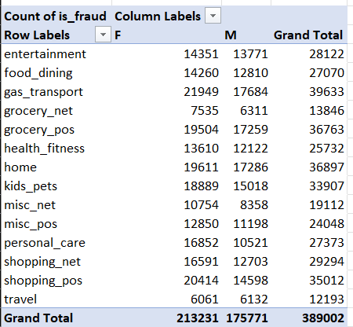
EXCEL ANALYSIS
Fraud count by gender and category

Slide 8
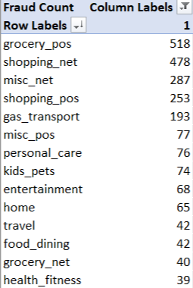
EXCEL ANALYSIS
Fraud by Categories

Slide 9























SQL ANALYSIS
Created finance schema and tables
Performed joins between transaction & location data
Calculated fraud percentage and category-wise metrics
Time-based transaction analysis

Slide 10
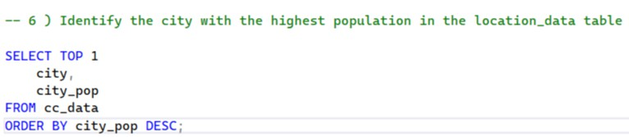

PROBLEMS

Slide 11
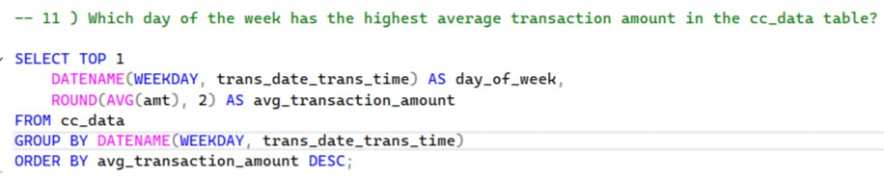
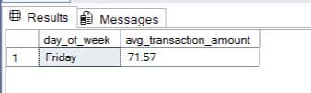
PROBLEMS

Slide 12
PYTHON EDA
Data quality and missing value checks
Distribution and outlier analysis Fraud vs non-fraud comparison Correlation analysis

Slide 13
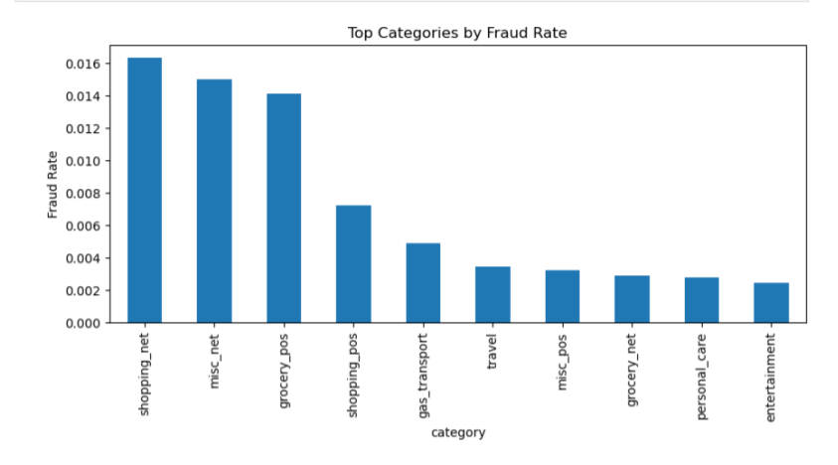

Slide 14
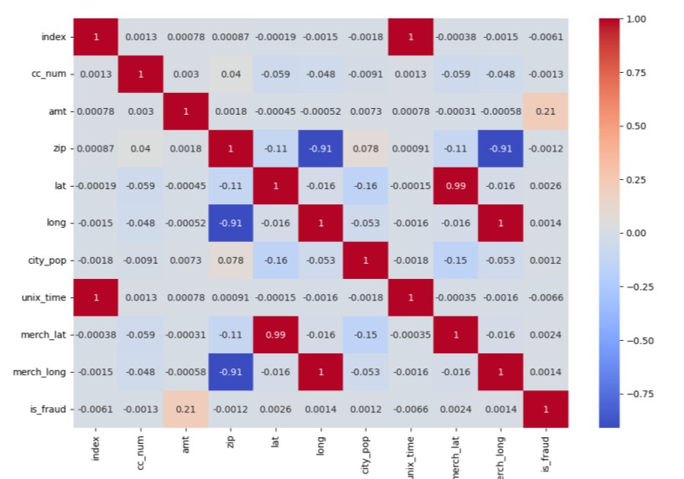
Correlation analysis

Slide 15
TABLEAU DASHBOARD
Transaction amount by gender and category
Geographic fraud distribution Monthly transaction trends Interactive dashboard for business users

Slide 16
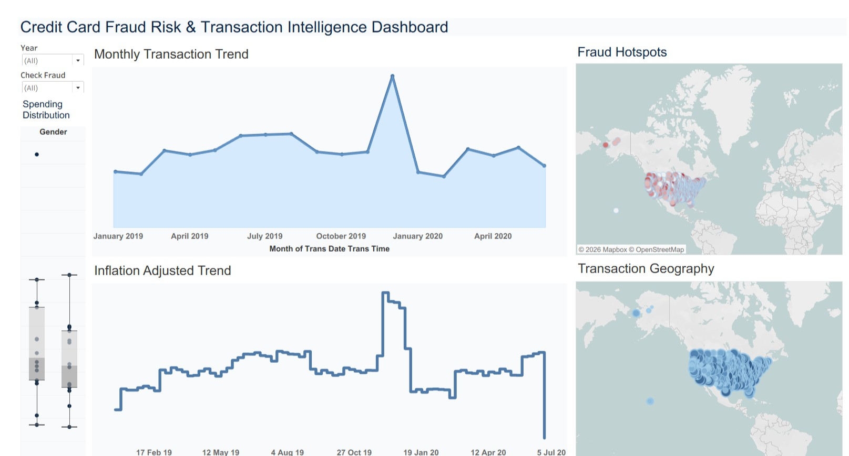
DASHBOARD

Slide 17
INSIGHTS
KEY INSIGHTS
Certain categories show higher fraud frequency Fraudulent transactions show abnormal amount patterns
Geographic clusters indicate high-risk regions
BUSINESS VALUE
Helps early fraud detection
Supports risk monitoring teams
Reduces financial loss and manual effort

Slide 18
CONCLUSION
End-to-end analytics project completed
Hands-on experience across Excel, SQL, Python, Tableau Focused on business-driven fraud analysis

Slide 19
THANK YOU
By Ali Hamza Shaikh

